Slide 1
Automate the Daily Backup Process using DevOps Tools
This seamless CI/CD pipeline integrates the power of Git, GitHub, Jenkins, Terraform, and Ansible to streamline the daily backup process and deployment.
Pa
By Pranshu Adlakha

Slide 2
Workflow to Automate Daily Backup using DevOps Tools
Automate the Backup Process using Jenkins
Commit Changes
1
The developer commits their code changes to the local Git repository.
2
Push to GitHub
The developer pushes the committed code to the private GitHub repository.
Code Stored Securely
3
The code is now safely stored in the private GitHub repository, ready for the next step in the pipeline.
4
Jenkins Pulls the Code
Jenkins pulls the code from the private GitHub repository for further processing.
Launch Resources on the Cloud
5
Jenkins uses Terraform to launch the necessary resources on the cloud platform.
6
Scheduled Backup with Ansible
Jenkins runs a scheduled backup on the control nodes using an Ansible playbook.
Backup Transfer to the Backup's Server
7
Jenkins copies the backup files to the Backup server using another Ansible playbook.

Slide 3
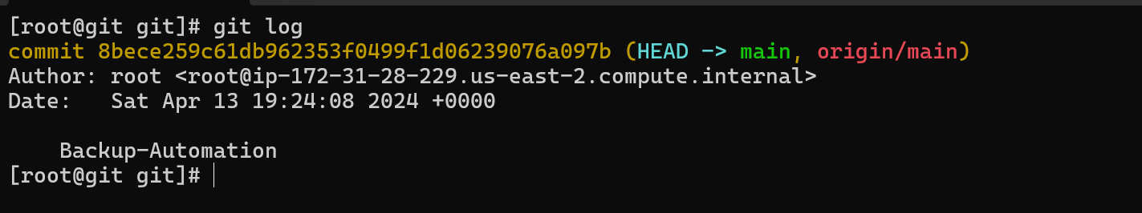
Push required files from
Git to GitHub

Slide 4
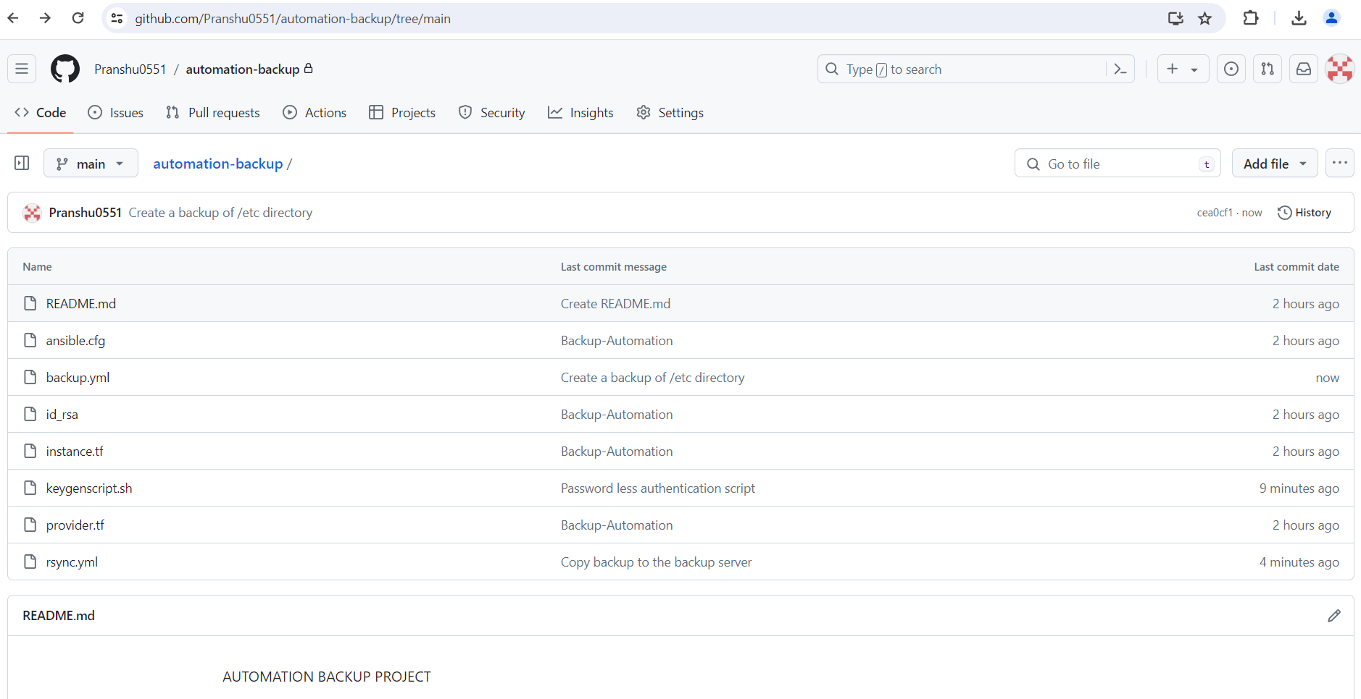
Files in GitHub
Private Repository

Slide 5
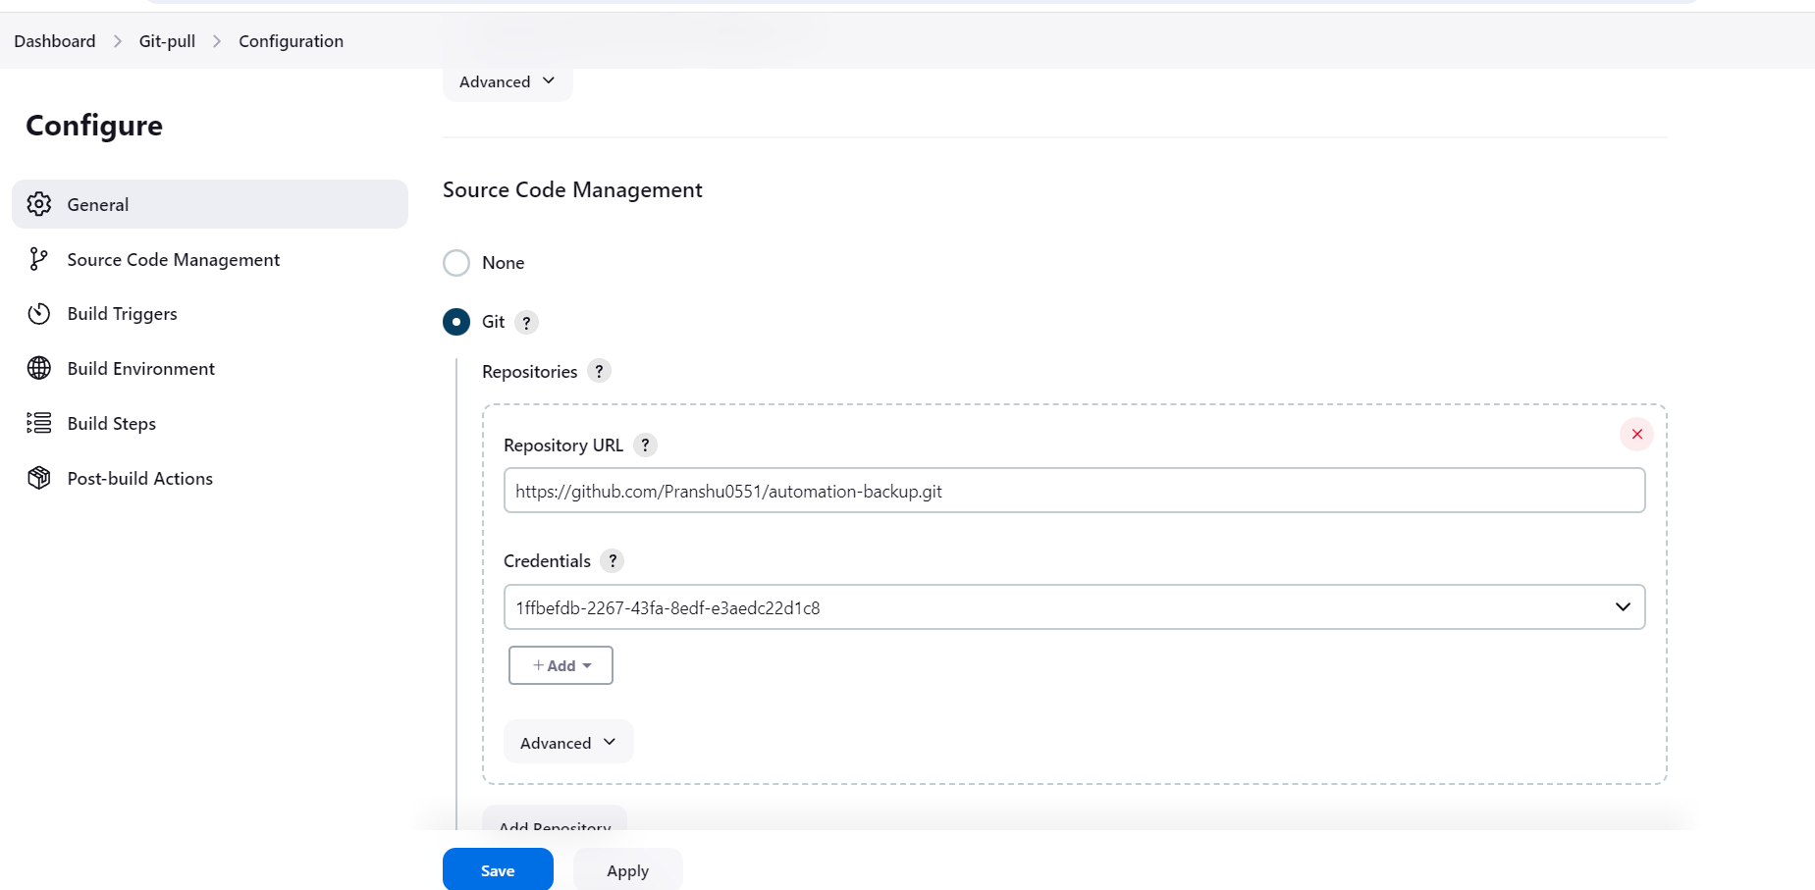
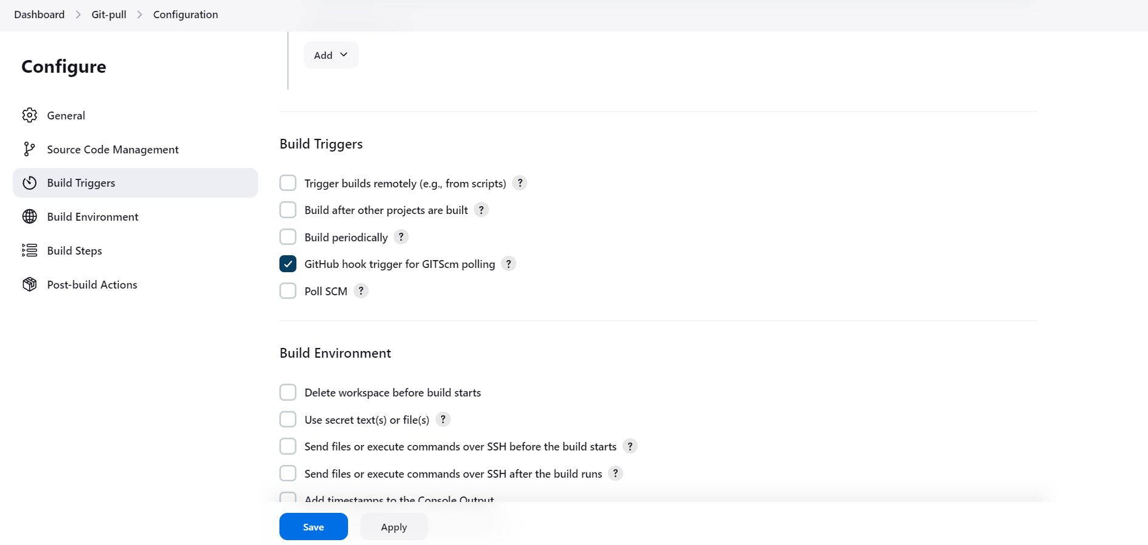
Pull contain from
GitHub to Jenkins

Slide 6
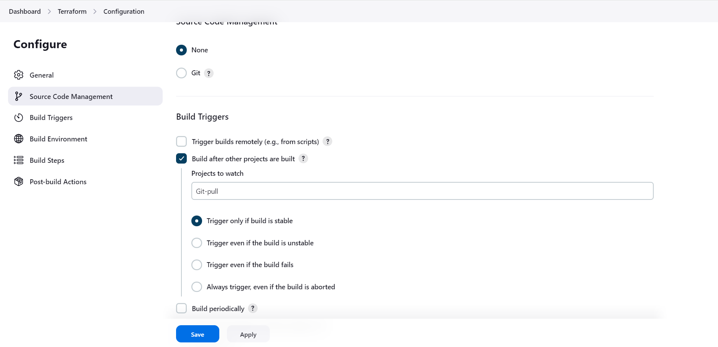
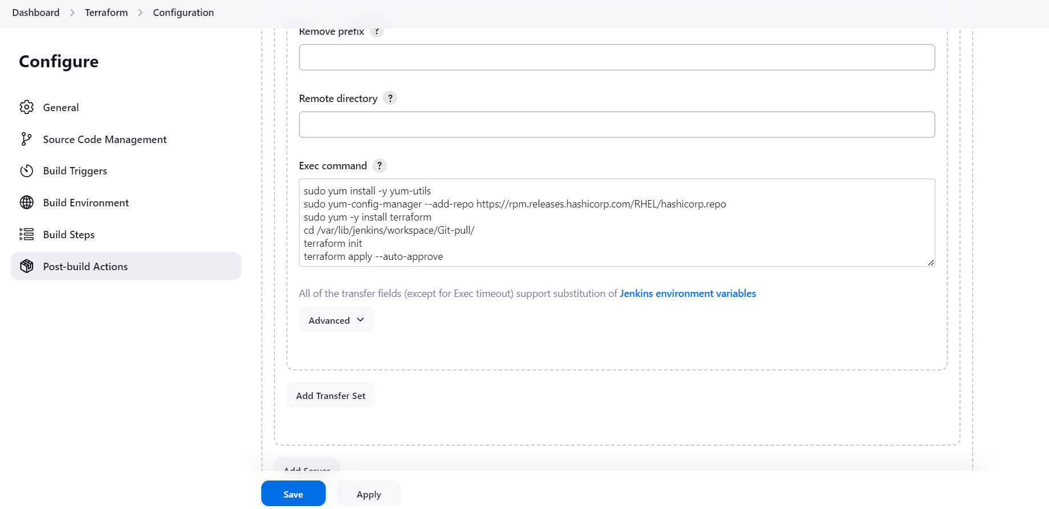
Create resources on Cloud using
Terraform through Jenkins

Slide 7
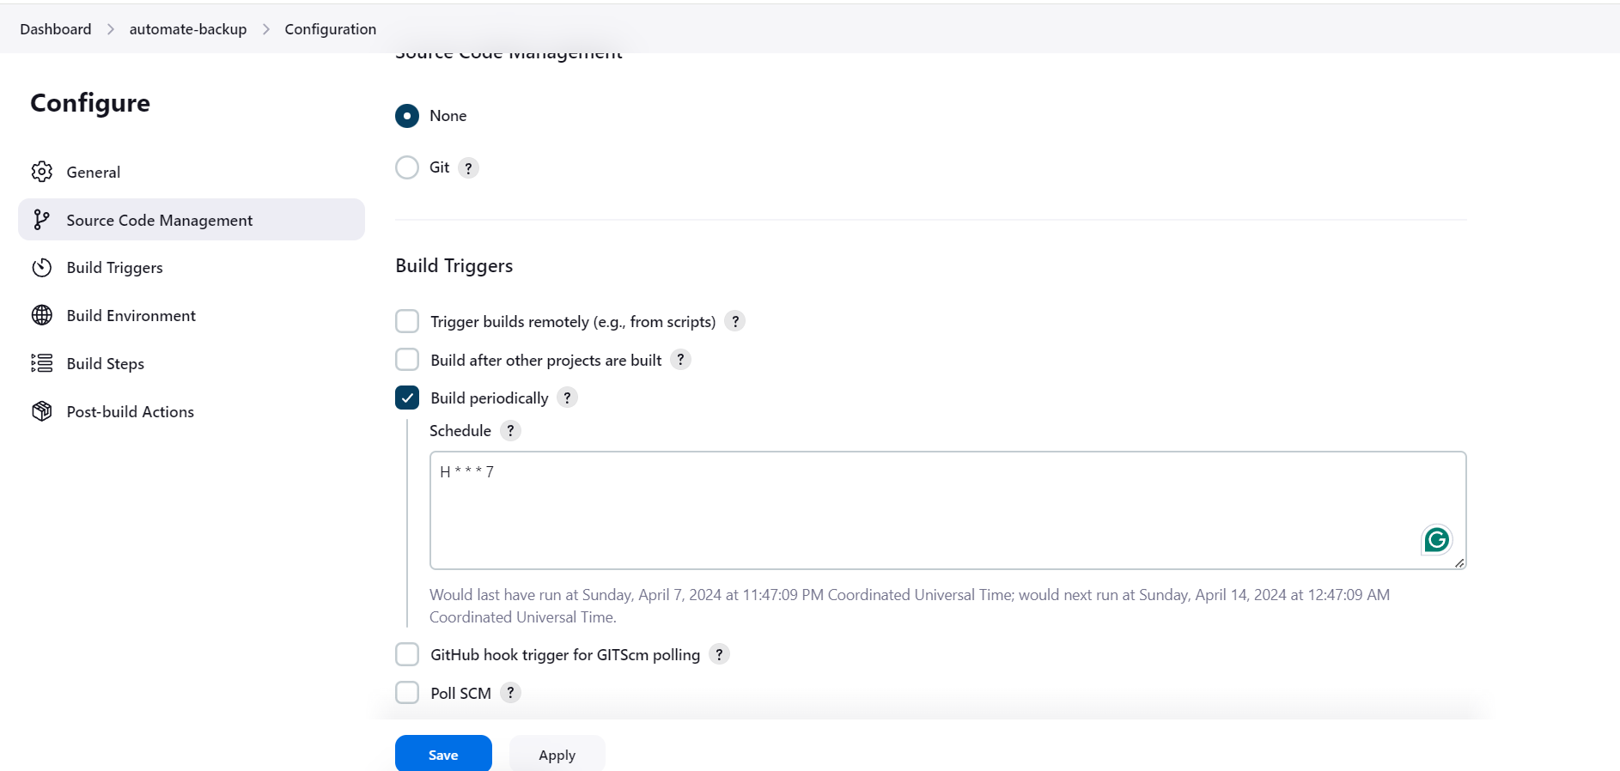
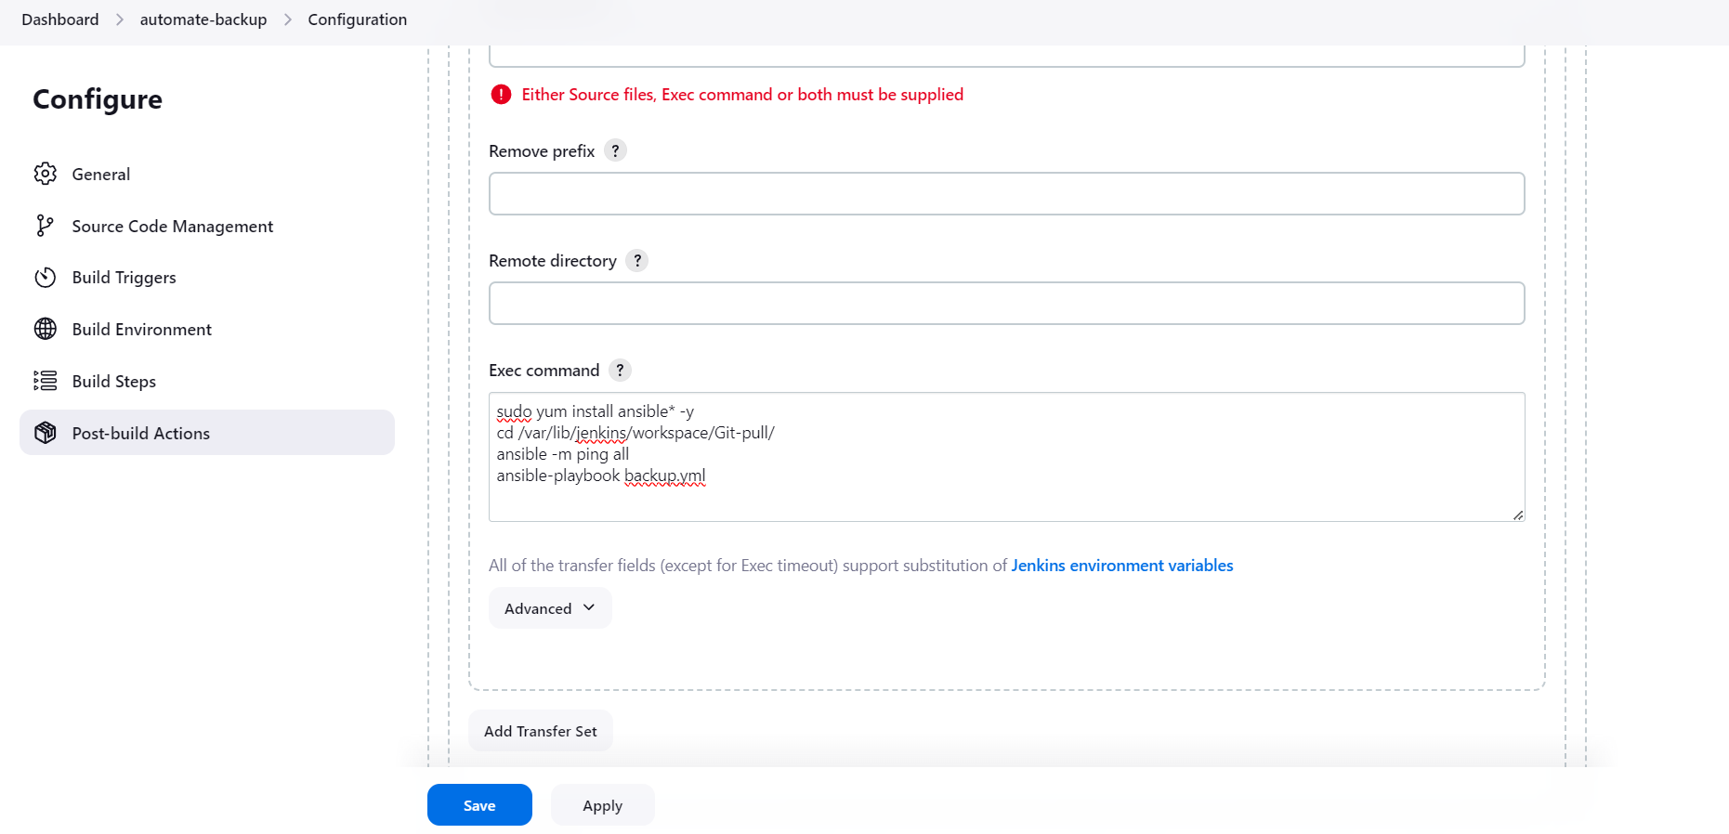
Schedule the Backup using
Ansible through Jenkins

Slide 8
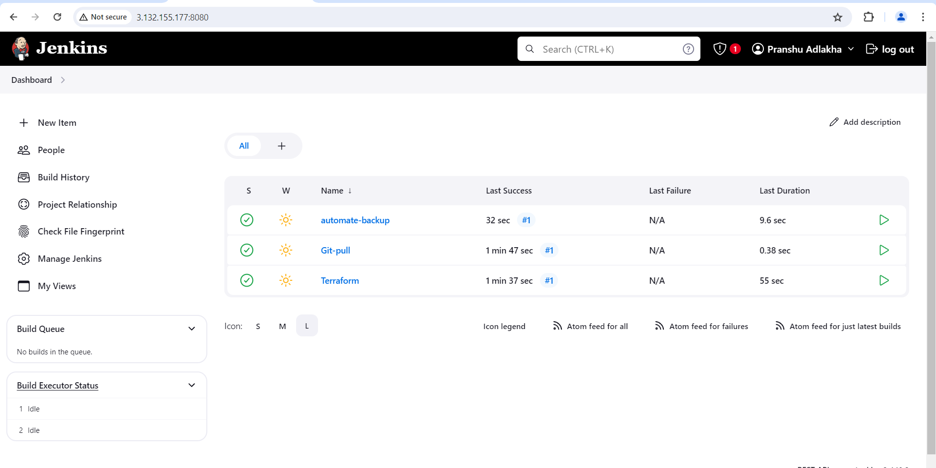
Run Jobs in Jenkins

